Slide 1
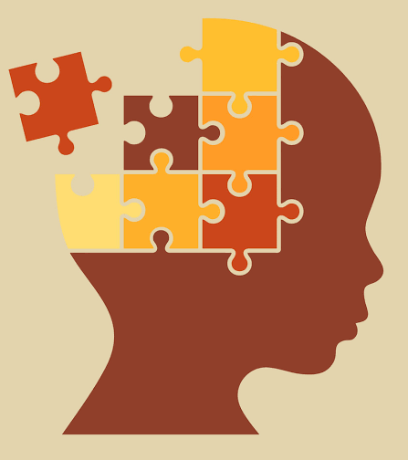
Thinking about Social Phenomena Constructing Puzzles
Lecture dt. Jan 20, 2020

Slide 2
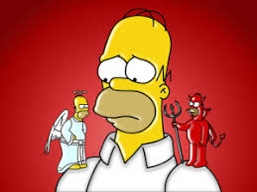
Motivations and behaviour
Motivations: An individual’s beliefs and desires that explain his/her behaviour. But,
Competing motivations
e.g. Faced by a bully, I am afraid and also angry. I want to run but also to hit him.
Motivational conflict

Slide 3
Motivations and behaviour
Examples
I need a book desperately and I am tempted to steal it from the library, but I also want to behave morally.
I want a candidate who favours economic development, but also one who favours freedom of religion.
I want to reduce poverty, but do not give money to beggars because…

Slide 4
Motivations and behaviour
Examples
I need a book desperately and I am tempted to steal it from the library, but I also want to behave morally.
I want a candidate who favours economic development, but also one who favours freedom of religion.
I want to reduce poverty, but do not give money to beggars because… I think giving to one individual makes no difference (conflict 1) or I want to promote my own interest (conflict 2)

Slide 5
Motivations and behaviour
Motivational conflict: how is it resolved?
Visceral motivations often stronger

Slide 6
Motivations and behaviour
Motivational conflict: how is it resolved?
Visceral motivations often stronger; urgent
physiology: hunger (through visual or olfactory cues)
emotion: fear, anger, shame, envy

Slide 7
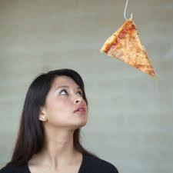
Motivations and behaviour
Motivational conflict: how is it resolved?
e.g. I have a craving for pizza, but want to remain healthy. Choose pizza, immediately regret!
urgency leading to risk-taking behaviours
e.g. crimes of passion; breaking traffic rules
Notes:
Going to supermarket when hungry
Anger and crimes of passion

Slide 8
Motivations and behaviour
Motivational conflict: how is it resolved?
Traffic rules
Speed thrills (motivation), but also kills (conflict)…
Protest
I want to join a protest (motivation), but…

Slide 9
Motivations and behaviour
Motivational conflict: how is it resolved?
Traffic rules
Speed thrills (motivation), but also kills (conflict)… sensation-seeking (motivation), urgent
Protest
I want to join a protest (motivation), but stay clear of police beatings. If concern for democratic rights is stronger than concern for self-preservation, I will join

Slide 10
Motivations and behaviour
Motivational conflict: how is it resolved?
reducing cognitive dissonance (mechanism)
When one motivation is stronger than the other, we look for evidence to strengthen reasons on one side (unconscious mind). We do this to reduce dissonance.
facilitates choice of behaviour
can support confirmation bias

Slide 11
Puzzle for Thursday
People rarely admit, to themselves and others, that they are ignorant.
Explain the theoretical basis and mechanism.

